Slide 1
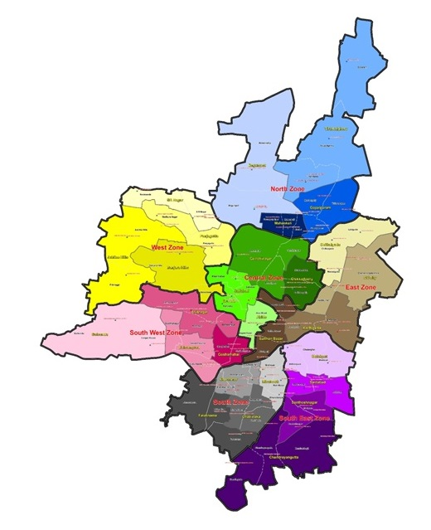
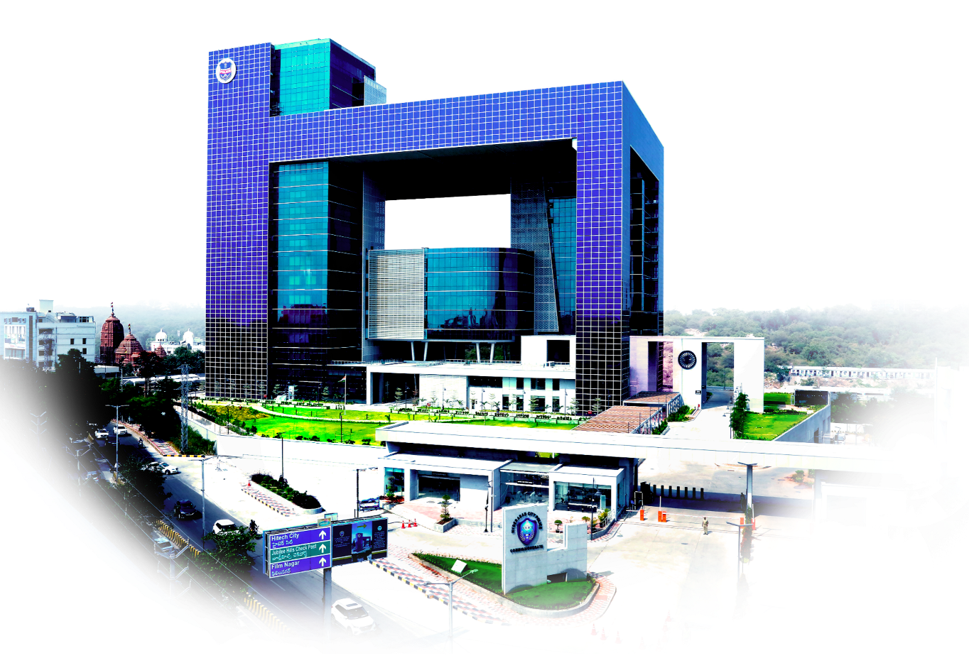
Reorganisation of
Hyderabad City Police in 2023
after
35 years

Slide 2
Rising Population in Hyderabad /HMDA area
Last time HCP was reorganized in 1987: Population was ≥ 25 lakhs
Semi-reorganization of HCP in 2002: 1 DCP Central Zone, 2 extra Addl. CsP, and 2 More Jt. CsP,
No. of Police Stations Reorganisation was not done.
In 2016, when new districts were created in Telangana, Hyderabad City’s organization remained same.
Population increase:
In 2011, it was ≥ 68 lakhs.
In 2021, it was ≥ 80 lakhs.
Daily floating is ≥ 10 – 15 lakhs.
Vehicles increase: -In 1987, vehicles population = 8,76,126 Lakhs
- In 2002 = 15,15,320 Lakhs
- In 2020 = 70,97, 036 Lakhs
- Now in 2023 = 80,70,852 Lakhs
In 3 Commissionerates, 1.6 crore + ≥ 40 lakhs floating population.
Therefore, TS Government felt the need for ‘Mega City Policing’ apart from improvement of infrastructure like roads and buildings to meet this challenge.

Slide 3
For Hyderabad City:
For Law & Order: Sanctioned 2 new DCP headed Zones, 11 new ACP Divisions, 11 New L&O stations,
i) 2 New DCP headed Zones: South East & South West
ii) 11 New ACP Divisions: Gandhi Nagar, Chilkalguda, Osmania University, Tirumalgherry, Chandrayangutta, Saidabad, Golconda, Kulsumpura, Chatrinaka, Jubilee Hills, SR Nagar
iii) 11 New Police Stations: Domalguda, Secretariat, Khairtabad, Warasiguda, Bandlaguda,
IS Sadan, Gudimalkapur, Film Nagar, Masab Tank,
Madhura Nagar, Borabanda.

Slide 4
Other Wings: 13 new Traffic Police Stations and 05 New Women Police stations and 1252 Police
personnel to deal with this objective of improving the Safety & Security apparatus for the
public.
For Traffic:
i) DCP Traffic Dist.-3 (Traffic Zone)- Total traffic districts - (03)
ii) ACP Traffic South East Division (New)- Total traffic divisions- 07
iii) 13 New Traffic Police Stations: SR Nagar, Jubilee Hills, Tolichowki, Langarhouse, Marredpally, Bowenpally, Bahadurpura, Santosh Nagar, Chandrayangutta, Amberpet, Nallakunta, Narayanguda, Chilkalguda.
For Women Safety:
5 New Women PS’s each in Central, East, West, South East, South West zones
Specialised Wings:
i) Task Force-02 new units
ii) IT Cell-01 unit
iii) Hyderabad Narcotic Enforcement Wing (H-NEW) -01 Unit
iv) Cyber Crime-01 Unit
v) New Secretariat Security-01 Unit

Slide 5
Reorganization Committee had officers with 3 decades of experiences in Hyderabad City Police.
Sri Iqbal Siddiqui, Addl. DCP, WZ,
Sri M. Srinivas Rao, Addl. DCP, CTC,
Sri. M. Sudarshan, ACP, Banjara Hills,
Sri J.Narsaiah, ACP, North Zone, SB,
Sri Ch.Y.Srinivas Kumar, ACP, CTC,
Sri K. Narsing Rao, ACP, CCS,
Sri Koteshwar Rao, ACP, Traffic West Central,
Sri V. Srinivas Reddy, ACP, Traffic South,
Sri P. Murali Krishna, ACP, Traffic Central.
All DCsP
All Jt. CsP/Addl.CsP
Worked for 6 months on the proposal.
Chaired by
Sri C.V. Anand, IPS.,
Commissioner of Police, Hyderabad.
&

Slide 6
criteria for creation of new zones/divisions/ police stations
Last 35 years population has TRIPLED. Therefore, some police stations became heavy, some light.
Burden of work due to Law and Order issues & festival bandobusts, Communal problems, Events, VIP movements to be more evenly spaced out for more focus.
Burden due to occurrence of crime – property and non property crime.
Population growth in those areas, urbanisation, colonies, basthis, migration etc.
Traffic problems, encroachments, VVIP and VIP movements and programmes and Events.
Geography and contiguity of Borders, Markets.
New infrastructure, Roads, Flyovers, Bridges, etc industrialisation.

Slide 7
Problems faced during Reorganization exercise
Anomalies in jurisdiction of certain roads, nalas, water bodies and no man’s land(s).
Bus station, Railway station, etc having common activities were in more than one jurisdiction.
VIP movements, Rallies coordination was a problem due to multiple jurisdictions.
Demographic and Geographic factors to bring similar activities under one Police Station/ Division/ Zone were considered.
The massive population growth and migration and economic developments in certain pockets had created lopsided burden of work on various Police units.
Eg: West Zone & Central Zone.

Slide 8
BOUNDARIES TAKEN INTO CONSIDERATION DURING THE EARMARKING OF THE BOUNDARIES OF POLICE STATIONS:
Musi River: Where ever Musi River is dividing the boundaries of two police stations, the center of the Musi River will be the boundary and the two police stations abutting the banks of Musi River will share the Musi River equally.
Bridges on Musi River: This also stands good for all the bridges on the Musi River which will be divided into half and each half shared by the respective police stations on their side
Water Bodies: This also stands good for the water bodies, if any water bodies are present between two police stations, which will be divided equally by both the police stations having boundaries with the water bodies.
Roads with medians: Where big roads with median are dividing the boundaries of two police stations, the median will form the boundary of the police stations and the road divided equally between both the police stations
Roads without medians: Where big roads without median are dividing the boundaries of two police station, the centre of the road will form the boundary of the police stations and the road divided equally between both the police stations.
Fly overs: Where there are fly overs running over the roads dividing the boundaries of the police stations, that portion on the fly over directly above the road will be the boundary and both the police stations will share the fly over accordingly.
Pillar Numbers: The police stations shall earmark the pillar numbers where pillar numbers are available.
Small internal roads: There will be some small internal roads which form part of the boundary and due to the width of the road, it may not be feasible to divide the road equally. In such situations the police stations shall share the boundary as per the original boundaries earmarked.

Slide 9
Old Map of HCP (2002)
(5 Zones, 17 Divisions, 60 police stations)

Slide 10
New Map of HCP : (7 zones, 28 divisions, 71 police stations)
New Zones
→South East
→South West

Slide 11
Categorisation of L&O Police Stations
Sl.No. | Category | No. of existing Police Stations | No. of Police Stations after re-organization | Existing & Revised for each Category | Sanctioned Strength for each category
 |  |  |  |  | CIs | SIs | ASIs | HCs | PCs | Total
1 | A | 18 | 7 | Existing | 2 | 6 | 8 | 18 | 86 | 120
 |  |  |  | Revised | 2 | 7 | 8 | 18 | 70 | 105
2 | B | 38 | 37 | Existing | 2 | 4 | 6 | 12 | 66 | 90
 |  |  |  | Revised | 2 | 5 | 6 | 12 | 60 | 85
3 | C | 4 | 27 | Existing | 1 | 2 | 4 | 10 | 53 | 70
 |  |  |  | Revised | 1 | 4 | 4 | 10 | 50 | 69
4 | D | 2 | 7 (Women Police Stations) | Existing | 1 | 2 | 3 | 6 | 43 | 55
 |  |  |  | Revised | 1 | 2 | 3 | 6 | 20 | 32
Total PSs |  | 62 | 78 | Total for 78 PS’s | 122 | 356 | 407 | 882 | 4200 | 291
Grand Total |  |  |  |  | 5967

Slide 12
CATEGORY-A (7): 1) SAIFABAD, 2) OSMANIA UNIVERSITY, 3) BANJARA HILLS, 4) JUBILEE HILLS, 5) FILMNAGAR, 6) PUNJAGUTTA,
7) CHARMINAR
CATEGORY-B (37): 1) ABIDS, 2) BEGUM BAZAAR, 3) MUSHEERABAD, 4) DOMALGUDA, 5) SECRETARIAT, 6) KHAIRTABAD, 7) BEGUMPET,
8) BOWENPALLY, 9) GOPALPURAM, 10) AMBERPET, 11) CHILKALGUDA, 12) NARAYANGUDA, 13) AFZALGUNJ,
14) MADHURA NAGAR, 15) SR NAGAR, 16) BORABANDA, 17) ASIF NAGAR, 18) HUMAYUNNAGAR,
19) SHAINAYATHGUNJ, 20) MANGALHAT, 21) GOLCONDA, 22) TAPPACHABUTRA, 23) HUSSAINIALAM,
24) BAHADURPURA, 25) MOGHALPURA, 26) CHATRINAKA, 27) MIRCHOWK, 28) REIN BAZAAR, 29) CHANDRAYANGUTTA, 30) BANDLAGUDA, 31) SANTOSH NAGAR, 32) IS SADAN, 33) MADANNAPET, 34) SAIDABAD, 35) MALAKPET,
36) CHADERGHAT, 37) DABEERPURA
CATEGORY-C (27): 1) CHIKKADPALLY, 2) GANDHI NAGAR, 3) NAMPALLY, 4) TUKARAMGATE, 5) MARREDPALLY, 6) RAMGOPALPET,
7) MAHANKALI, 8) MARKET, 9) BOLLARUM, 10) TIRUMALGHERRY, 11) KHARKHANA, 12) KACHIGUDA, 13) LALAGUDA, 14) WARASIGUDA, 15) NALLAKUNTA, 16) SULTAN BAZAAR, 17) MASAB TANK, 18) HABEEBNAGAR, 19) LANGAR HOUSE, 20) GUDIMALKAPURA, 21) KULSUMPURA, 22) KALAPATHER, 23) KAMATIPURA, 24) FALAKNUMA,
25) SHAHLIBANDA, 26) BHAVANI NAGAR, 27) KANCHANBAGH

Slide 13
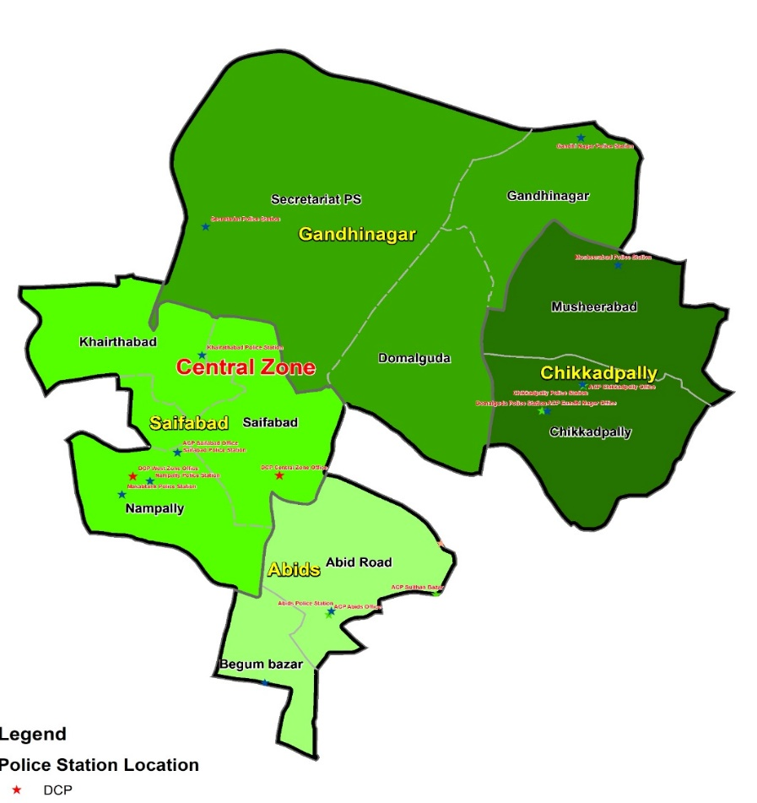
Division | ACP Office-location | Police Stations | Category Of Police Stations | Created With Areas From Police Station | Location Of PS
Abids | Hyd Collectorate building | Abids Road PS | B |  | Hyd Collectorate building
 |  | Begum Bazaar | B |  | Existing
Chikkadpally | Existing | Chikkadpally | C |  | Building, Opp. Hanuman Temple, Vivek Nagar, Chikkadpally
 |  | Musheerabad | B |  | Existing
Gandhinagar | BRK Bhavan, Ground Floor | Gandhi Nagar | C |  | Existing
 |  | Domalguda | B |  | Old Chikkadpally PS Building At X Rds.
 |  | DOMALGUDA | B | Chikkadpally
 |  |  |  | Gandhi Nagar
 |  |  |  | Narayanguda
 |  | Secretariat PS | B |  | BRK Bhavan, Ground Floor
 |  | Secretriat PS (Some aread Added-sanjeevaiah Park, till bible house) | B | Ramgopalpet
 |  |  |  | Mahankali
 |  |  |  | Panjagutta
 |  |  |  | Saifabad
Saifabad | Existing | Saifabad | A |  | Existing
 |  | Nampally | C |  | Existing
 |  | Khairatabad | B |  | Traffic PS Saifabad, Opp. IMAX
 |  | KHAIRATABAD | B | Panjagutta
 |  |  |  | Saifabad
4-divisions |  | 10-ps’s
Central Zone
Location of Zonal Office:
Fateh Maidan, Abids, Hyderabad

Slide 14
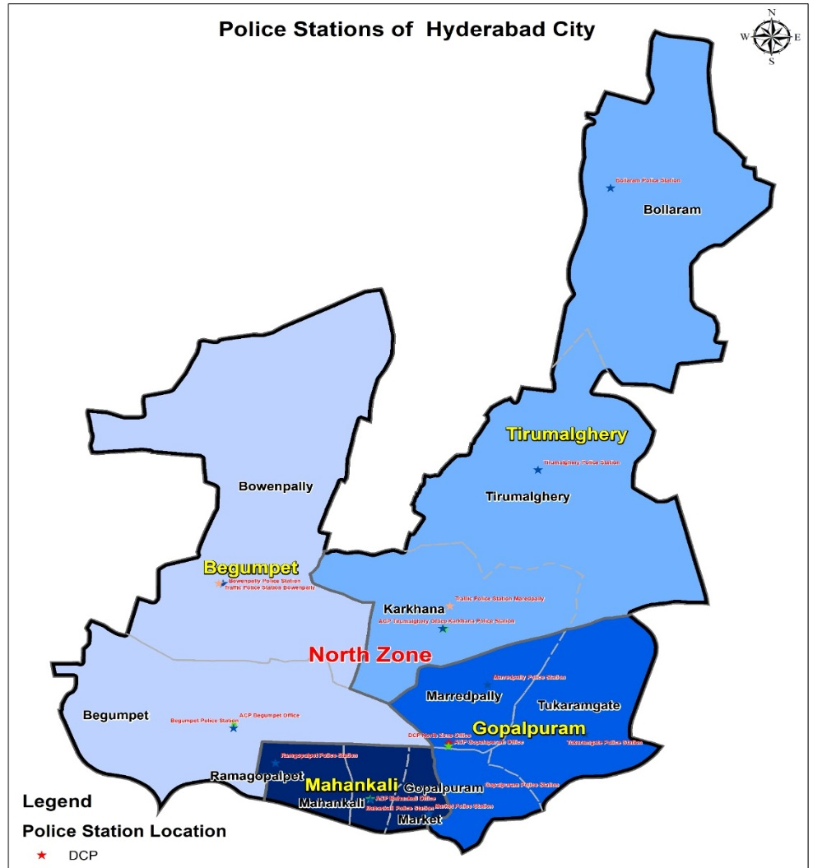
North Zone
Division | ACP Office-location | Police Stations | Category Of Police Stations | Created With Areas From Police Station | PS Location
Begumpet | Existing | Begumpet | B |  | Existing
 |  | Bowenpally | B |  | Existing
Gopalpuram | Existing | Gopalpuram | B |  | Existing
 |  | Tukaramgate | C |  | Existing
 |  | Marredpally | C |  | Existing
Mahankali | Existing | Ramgopalpet | C |  | Existing
 |  | Mahankali | C |  | Existing
 |  | Market | C |  | Existing
Tirumalgherry | Kharkhana PS Building, 2nd Floor | Bollarum | C |  | Existing
 |  | Tirumalgherry | C |  | Existing
 |  | Karkhana | C |  | Existing
4-divisions |  | 11-ps’s
Location of Zonal Office:
Nehru Nagar Colony, West Marredpally, Secunderabad

Slide 15
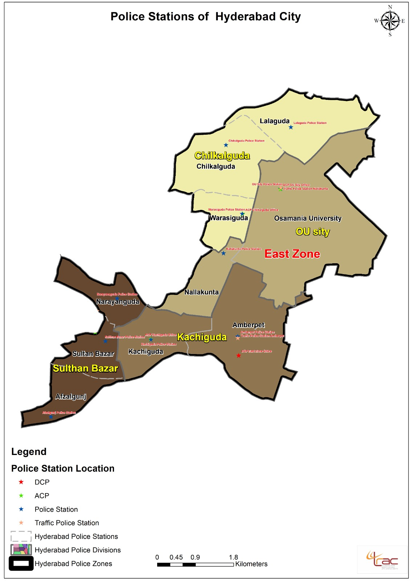
Division | ACP Office-location | Police Stations | Category Of Police Stations | Created With Areas From Police Station | PS Location
Kachiguda | Existing | Amberpet | B |  | Existing
 |  | Kachiguda | C |  | Existing
Chilkalguda | Boudha Nagar Community Hall, 1st Floor | Lalaguda | C |  | Existing
 |  | Chilkalguda | B |  | Existing
 |  | Warasiguda | C |  | Boudha Nagar GHMC Community Hall
 |  | WARASIGUDA |  | Musheerabad
 |  |  |  | Chilkalguda
 |  |  |  | Nallakunta
Osmania University | Existing O.U. PS Building | Osmania University | A |  | Existing
 |  | Nallakunta | C |  | Existing
Sultan Bazar | Existing | Sultan Bazar | C |  | Existing
 |  | Afzalgunj | B |  | Existing
 |  | Narayanguda | B |  | Existing
4-divisions |  | 10-ps’s
East Zone
Location of Zonal Office:
Moosarambagh Rd, Premnagar, Police Colony, Amberpet

Slide 16
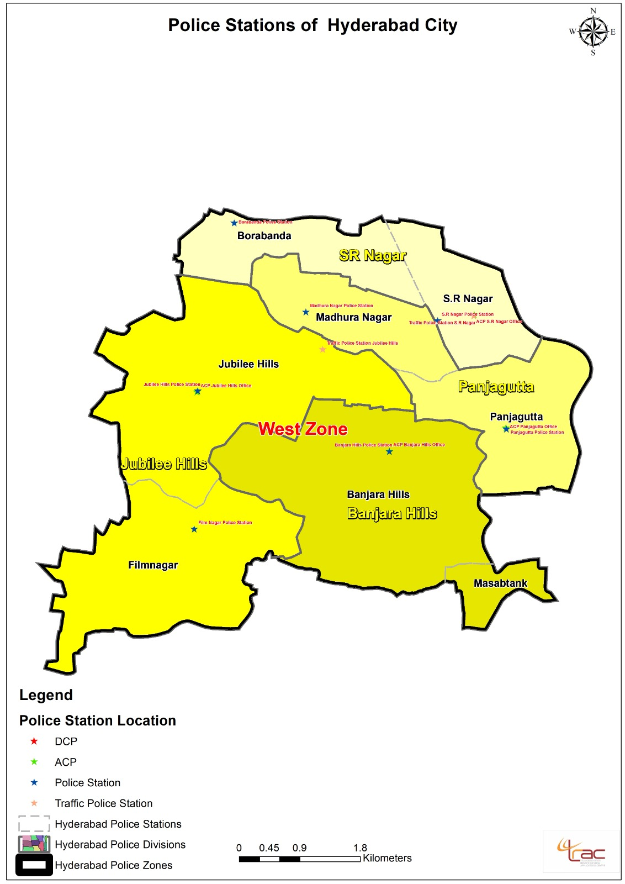
Division | ACP Office-location | Police Stations | Category Of Police Stations | Created With Areas From Police Station | PS Location
Banjara Hills | Existing | Banjara Hills | A |  | Existing
 |  | Masab Tank | C |  | Existing Humayun Nagar PS Building At Shanthi Nagar
 |  | MASAB TANK (Add ½ Jn. Amrutha valley to down) | C | Saifabad
 |  |  |  | Humayun Nagar
 |  |  |  | Banjara Hills
Jubilee Hills | Jubilee Hills PS 2nd Floor | Jubilee Hills | A |  | Existing
 |  | Film Nagar | A |  | Film Nagar Co-operative Credit Society Premises
 |  |  |  | Golconda
 |  | FILM NAGAR | A | Jubilee Hills
 |  |  |  | Banjara Hills
Panjagutta | Existing | Panjagutta | A |  | Existing
 |  | Madhura Nagar | B |  | Existing Rahmath Nagar OP Building
 |  | MADHURA NAGAR |  | Jubilee Hills
 |  |  |  | S.R Nagar
S. R Nagar | Existing SR Nagar Tr. PS Building | S.R Nagar | B |  | Existing
 |  | Borabanda | C |  | Borabanda Police Out Post
 |  |  |  | Jubilee Hills
 |  | BORABANDA |  | S.R Nagar
4-divisions |  | 8-ps’s
West Zone
Location of Zonal Office:
AC Guards, Masab Tank, Hyderabad

Slide 17
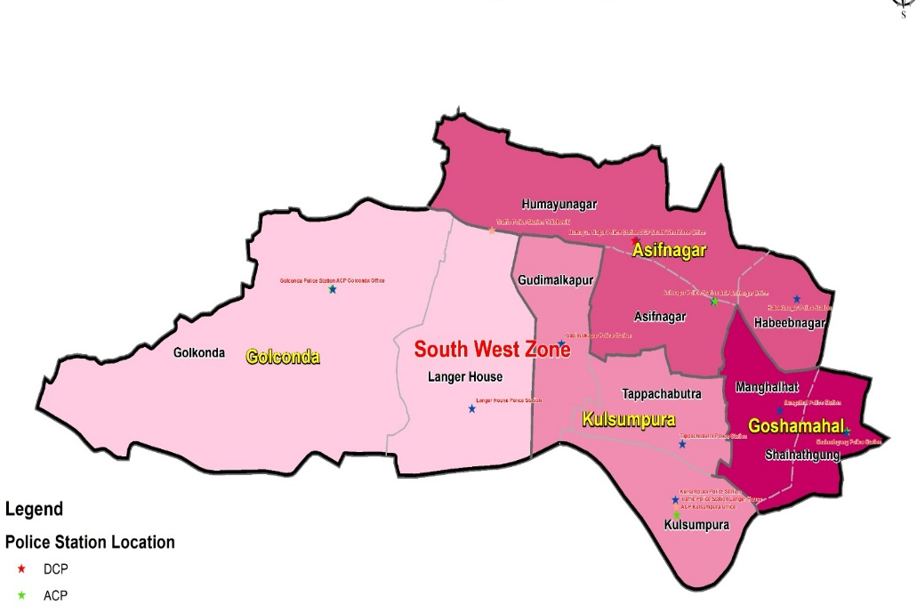
Division | ACP Office-location | Police Stations | Category Of Police Stations | Created With Areas From Police Station | PS Location
Asif Nagar | New Asif Nagar PS Building | Asif Nagar | B |  | Existing
 |  | Humayun Nagar | B |  | Existing
 |  | Habeeb Nagar | C |  | Existing
Goshamahal | Existing | Shainayathgunj | B |  | Existing
 |  | Mangalhat | B |  | Existing
Golconda | Golconda L&O PS building | Golconda | B |  | Existing
 |  | Langar House | C |  | Existing
Kulsumpura | Kulsumpura Old PS | Gudimalkapur | C |  | Rythu Vishranthi Bhavan, Market Yard, Gudimalkapur
Kulsumpura | Old PS Kulsumpura | Gudimalkapur | C | Asif Nagar
 |  |  |  | Langar House
 |  |  |  | Tappachabutra
 |  |  |  | Kulsumpura
 |  | Kulsumpura | C |  | Existing
 |  | Tappachabutra | B |  | Existing
4 Divisions |  | 10 Ps’s
South West Zone
Location of Zonal Office:
Existing ACP Asifnagar Office, Mehdipatnam
Addl. DCP: New Humayun nagar Police Station

Slide 18
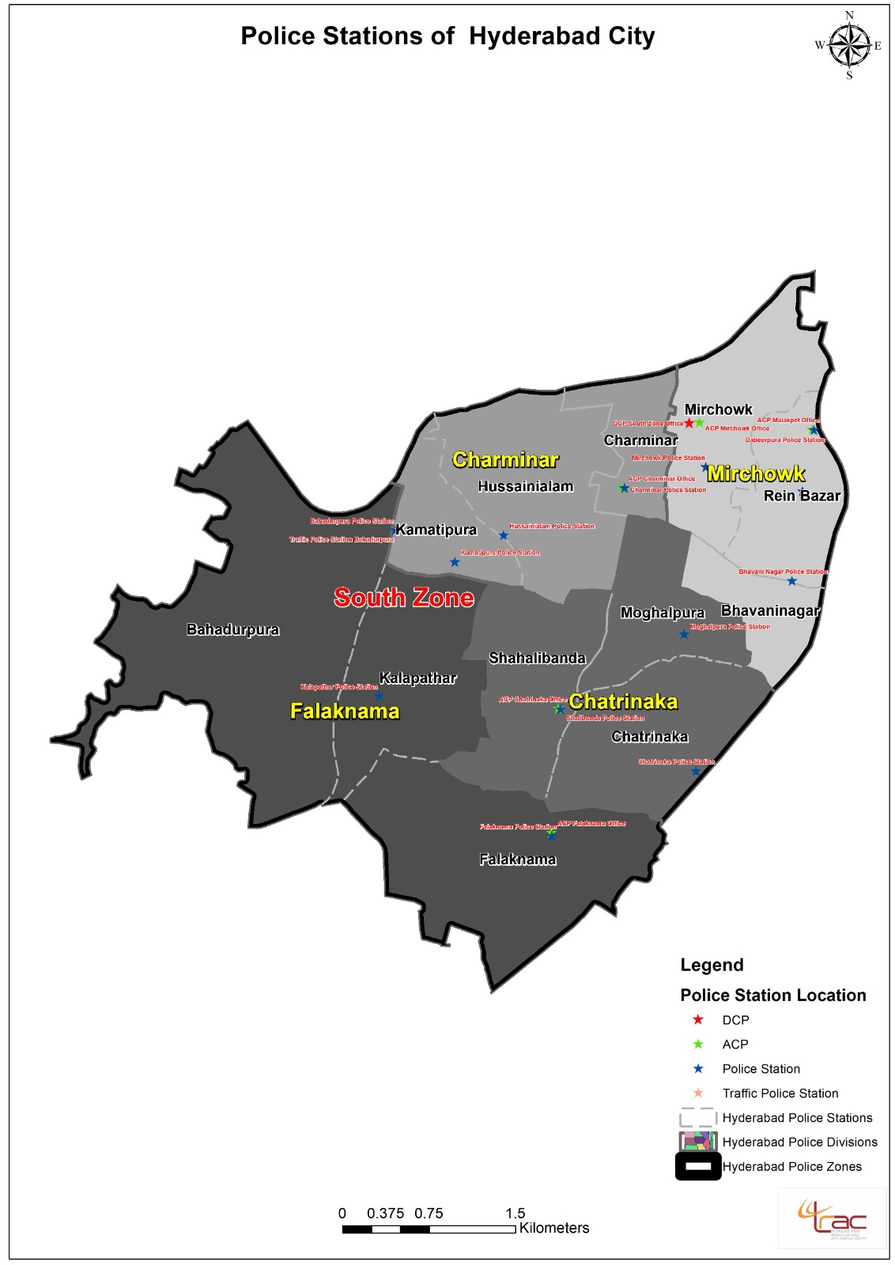
South Zone
Division | ACP Office Location | Police Stations | Category Of Police Stations | Created With Areas From Police Station | PS Location
Charminar | Existing | Charminar | A |  | Existing
 |  | Kamatipura | C |  | Existing
 |  | Hussainialam | B |  | Existing
Falaknuma | Existing | Falaknuma | C |  | Existing
 |  | Bhadurpura | B |  | Existing
 |  | Kalapathar | C |  | Existing
Chatrinaka | Quarter Beside New Shalibanda PS Building | Moghalpura | B |  | Existing
 |  | Chatrinaka | B |  | Existing
 |  | Shalibanda | C |  | Existing
Mirchowk | Existing | Mirchowk | B |  | Existing
 |  | Bhavaninagar | C |  | Existing
 |  | Rein Bazar | B |  | Existing
4-divisions |  | 12-ps’s
Location of Zonal Office:
Chatta Bazaar, Pathar Gatti, Hyderabad

Slide 19
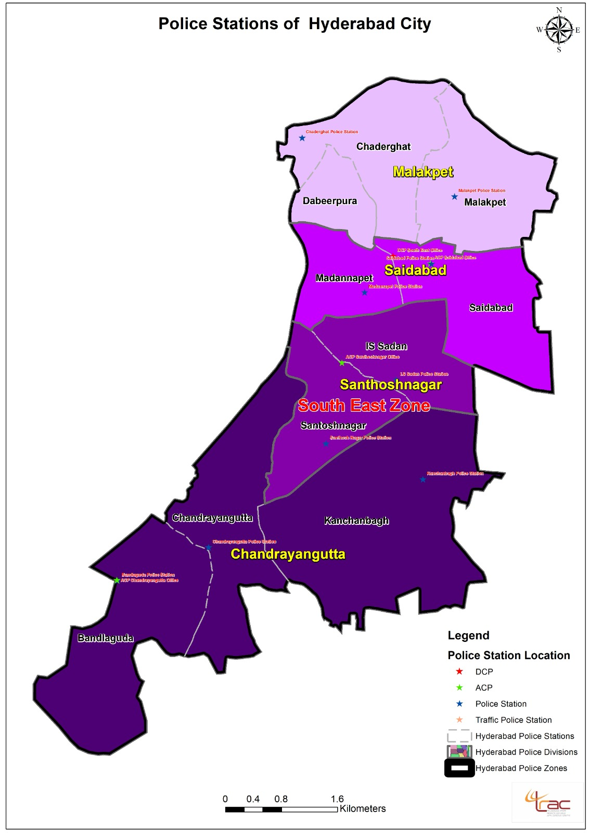
Division | ACP Office Location | Police Stations | Category Of Police Stations | Created With Areas From Police Station | PS Location
Chandrayan-gutta | Police Sub-control Building At Bandlaguda infront of PS Building | Chandrayangutta | B |  | Existing
 |  | Bandlaguda | B |  | New Building At Bandlaguda
 |  | BANDLAGUDA | B | Chandrayangutta
 |  | Kanchanbagh | C |  | Existing
Santosh Nagar | Existing | Santosh Nagar | B |  | Building At Rakshapuram Opp. To Model Market
 |  | I S Sadan | B |  | Newly Constructed Building For Santosh Nagar PS
 |  | I S SADAN (Some area added in Saidabad) | B | Kanchanbagh
 |  |  |  | Santoshnagar
 |  |  |  | Madannapet
 |  |  |  | Saidabad
Saidabad | Saidabad Police station 1st floor. | Madannapet | B |  | Existing
 |  | Saidabad | B |  | Existing
Malakpet | Dabeerpura PS 1st Floor | Malakpet | B |  | Existing
 |  | Chaderghat | B |  | Existing
 |  | Dabeerpura | B |  | Existing
4-divisions |  | 10-ps’s
South East Zone
Location of Zonal Office:
New building near Old ACP Malakpet Office, Saidabad

Slide 20
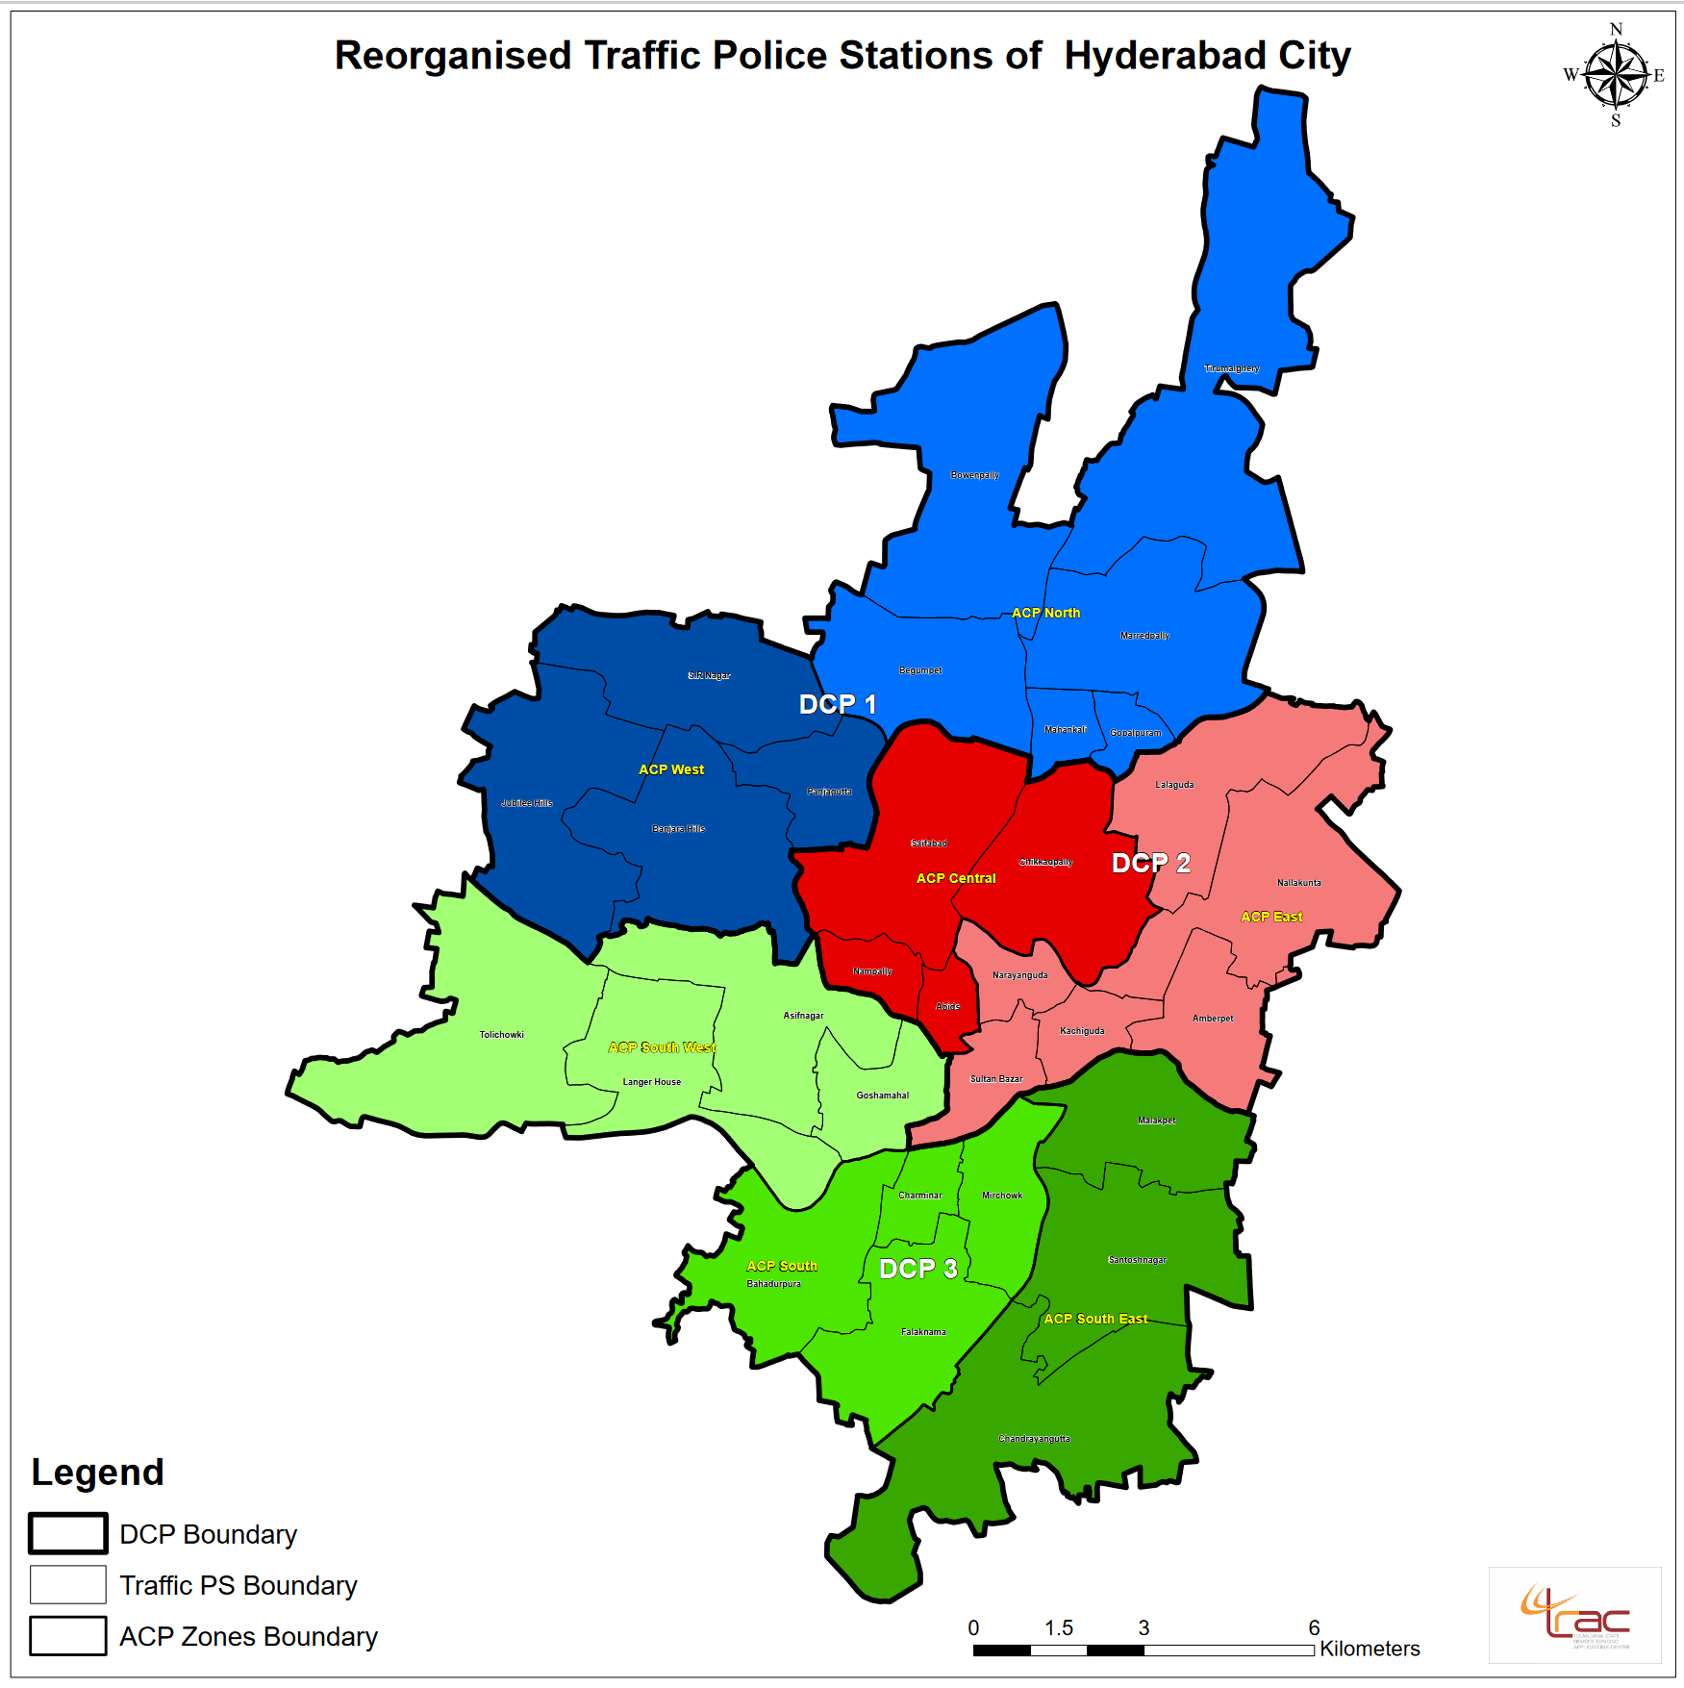
Traffic Wing Reorganization

Slide 21
Categorisation of Traffic Police Stations
Sl.No. | Category | No. of existing Police Stations | No. of Police Stations after re-organization | Existing & Revised for each Category | Sanctioned Strength for each category
 |  |  |  |  | CIs | SIs | ASIs | HCs | PCs | Total
1 | A | 4 | 1 | Existing | 2 | 6 | 8 | 18 | 86 | 120
 |  |  |  | Revised | 1 | 7 | 8 | 18 | 70 | 104
2 | B | 9 | 9 | Existing | 2 | 4 | 6 | 12 | 66 | 90
 |  |  |  | Revised | 1 | 5 | 6 | 12 | 60 | 84
3 | C | 5 | 7 | Existing | 1 | 2 | 4 | 10 | 53 | 70
 |  |  |  | Revised | 1 | 5 | 4 | 10 | 50 | 70
4 | D | 0 | 14 | Existing | 1 | 2 | 3 | 6 | 43 | 55
 |  |  |  | Revised | 1 | 2 | 3 | 6 | 20 | 32
Total PSs |  | 18 | 31 | Total | 31 | 115 | 132 | 280 | 1240 | 290
Grand Total |  |  |  |  | 1798

Slide 22
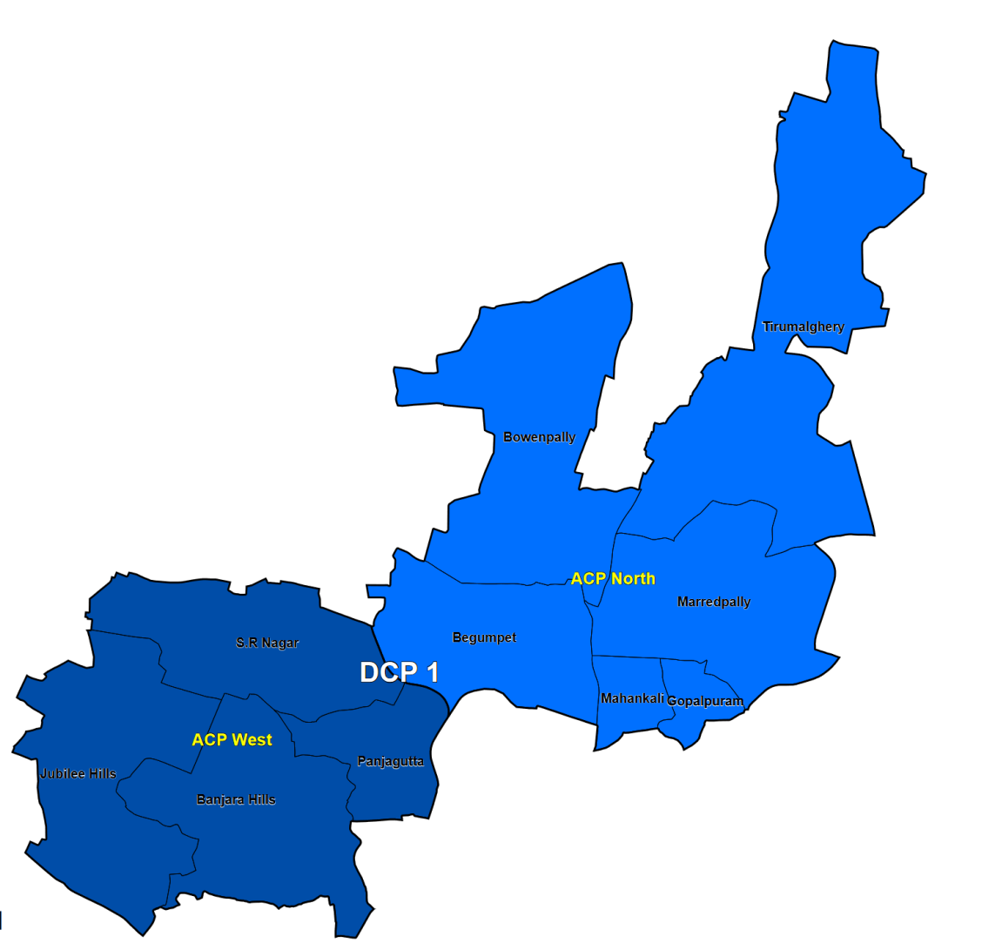
Zone | Division | Location Of ACP Office | Traffic Police Stations | Category Of Police Stations | Location Of PS
DCP-1 | ACP, North | Existing | Begumpet | C | Existing
 |  |  | Gopalpuram | C | Existing
 |  |  | Mahankali | B | Existing
 |  |  | Marredpally | D | Old L&O Kharkhana PS
 |  |  | Tirumalgherry | C | Existing
 |  |  | Bowenpally | D | Old Bowenpally L&O Police
 | ACP, West | Existing | Panjagutta | B | Existing
 |  |  | S.R Nagar | C | Old L&O SR Nagar PS
 |  |  | Banjara Hills | B | Existing
 |  |  | Jubilee Hills | B | TSSP I Batalion. Quaters Block 5, Qtr. No.25
 | 2-divisions |  | 10-PS’s
Traffic Wing – (DCP-1)
Location of Traffic Zonal Office:
2nd Floor, Traffic complex, Nampally

Slide 23
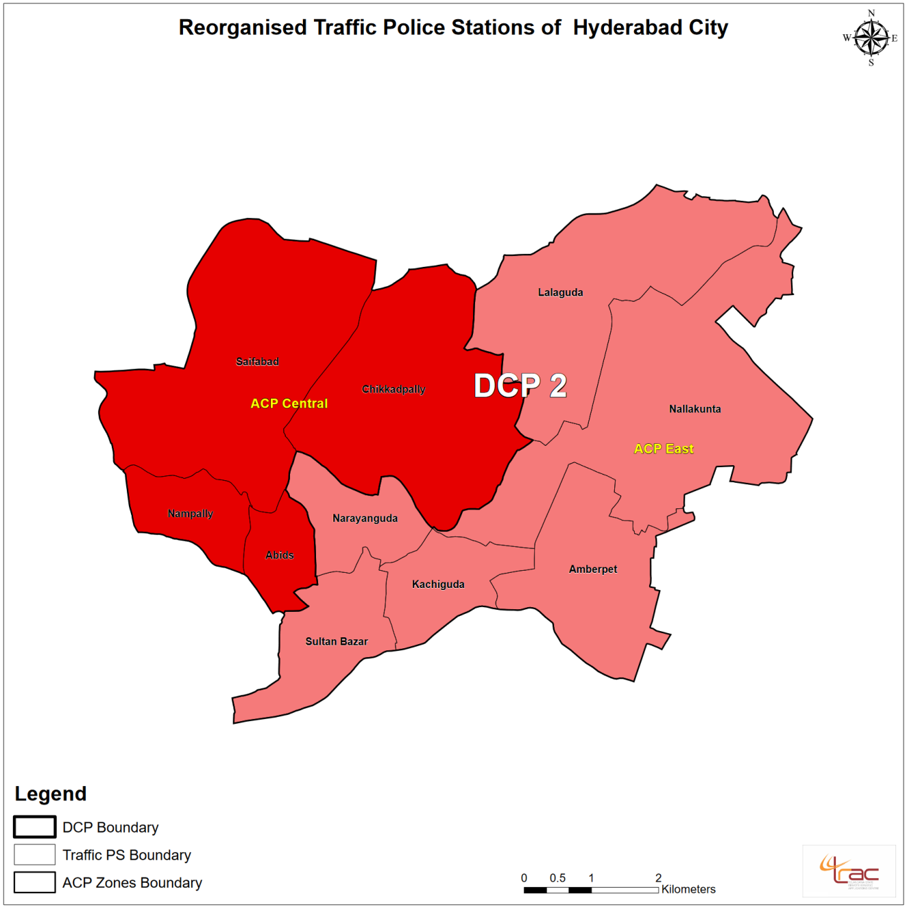
Traffic Wing–(DCP-2)
Zone | Division | Location Of ACP Office | Traffic Police Stations | Category Of Police Stations | Location Of PS
DCP-2 | ACP, Central | Khairatabad PS buiding | Chikkadpally | B | Existing
 |  |  | Abids | D | Old Abids L&O PS building
 |  |  | Saifabad | A | Shifted to 3rd floor
 |  |  | Nampally | D | Existing
 | ACP, East | Existing | Kachiguda | D | Old Tr. PS Kachiguda At Nimboliadda
 |  |  | Amberpet | D | New Tr.PS Of Kachiguda
 |  |  | Nallakunta | C | In L&O O.U. PS Premises
 |  |  | Sulthanbazar | B | Existing
 |  |  | Narayanguda | D | Existing
 |  |  | Chilkalguda | D | Yet to be Finalised
 | 2-divisions |  | 10-PS’s
Location of Traffic Zonal Office:
2nd Floor, Traffic complex, Nampally

Slide 24
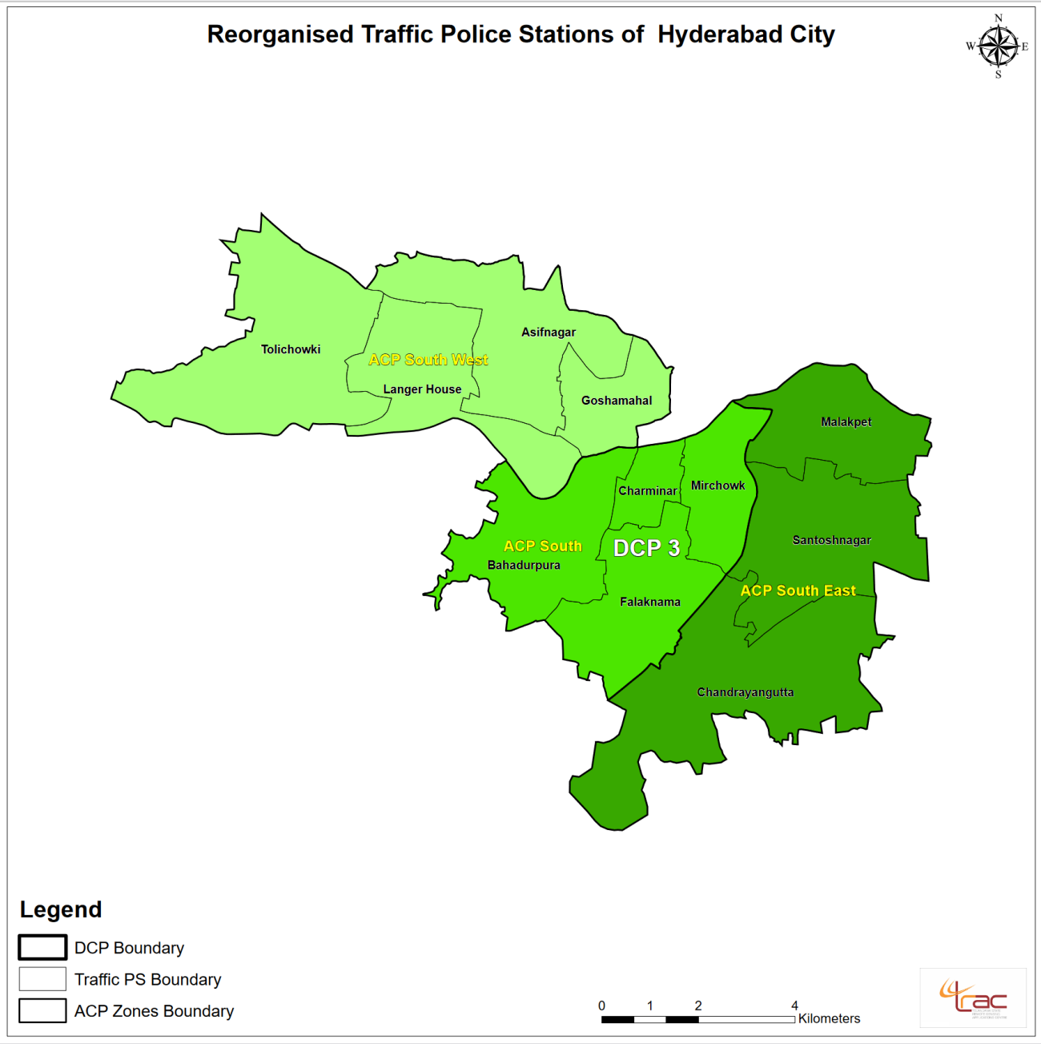
Traffic Wing–(DCP-3)
Zone | Division | Location Of ACP Office | Traffic Police Stations | Category Of Police Stations | Location Of PS
DCP-3 | ACP, South West | Existing ( At Goshamahal TTI) | Asif Nagar | D | Existing
 |  |  | Tolichowki | D | Old Golconda L&O Police stationxisting
 |  |  | Langar House | B | Old Kulsumpura L&O PS
 |  |  | Goshamahal | B | Existing
 | ACP, South | Existing | Mirchowk | D | Existing
 |  |  | Charminar | C | Existing
 |  |  | Bahadurpura | D | Bahadurpura Police Lines
 |  |  | Falaknuma | C | Existing
 | ACP, South East | 1st Floor, Bandlaguda Sub-Control out post building | Santosh Nagar | D | Old PS Saidabad Community Hall, SBI Colony, Saidabad
 |  |  | Chandrayangutta | D | Old Outpost Of Bandlaguda PS In Front Of New Bandlaguda L&O PS
 |  |  | Malakpet | B | Existing
3-divisions |  |  | 11-PS’s
Location of Traffic Zonal Office &
Addl. DCP Traffic office: At Purani Haveli

Slide 25
WOMEN SAFETY WING
Main Bharosa centre and other Bharosa centres/Family Counselling Centres
SHE Teams
7 Women Police Stations:
@ 1 in each Zone
All Category ‘D’
1 Insp., 2 SIs, 3 ASIs, 6 HCs, 20 PCs = Total- 32
Central Zone Women PS- Located in Old Cybercrime PS, CCS in Old PCR South Zone Women PS- Located in present WPS, South Zone North Zone Women PS- Located in present WPS, North Zone, Begumpet Police Lines West Zone Women PS- Located at Entrance of Yousufguda 1st Battalion. East Zone Women PS- Located at Amberpet P.S., Old Building South West Zone Women PS-Vivekanand Colony, Asif Nagar Community hall South East Zone Women PS- Saidabad outpost building, Shankeshwar Nagar, Saidabad.

Slide 26
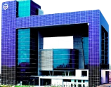
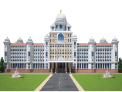
Other New Specialised Units in HCP
1. CCS, DD & SIT = 1 DCP, 2 Addl. DCsP, 18 ACsP, 24 Inspectors, 99 SIs, 121 HCs, 364 PCs = Total- 629 (Earlier 416)
2. Cyber Crimes (New) = 1 DCP, 1 Addl. DCP, 1 ACP, 09 Inspectors, 20 SIs, 09 ASIs, 11 HCs, 96 PCs
= Total- 148 (Earlier ‘0’)
3. ICCC = 1 DCP, 10 Inspectors, 13 SIs, 138 PCs = Total- 162
= L&O - 02 ACsP, 02 Inspectors, 03 SIs, 03 HCs, 20 PCs = Total- 30
= Traffic - 01 Inspector, 20 PCs = Total- 21
5. Zonal PCRs (7) = 01 Inspector, 02 SIs, 01 ASI, 02 HCs, 04 PCs = Total- 10 X 7 = 70
4. Secretariat Security (New)

Slide 27
Other New Specialised Units in HCP
6. Traffic Admin. Unit (New) = 1 Addl. DCP, 1 ACP, 13 Inspectors, 15 SIs, 06 ASIs, 25 HCs, 70 PCs = Total- 131
7. Social Media & IT Cell (New) = 04 Inspectors, 14 SIs, 07 ASIs, 18 HCs, 200 PCs = Total- 243
8. HNEW (New) (Located in Old WPS, CCS) = 02 Inspectors, 04 SIs, 04 ASIs, 04 HCs, 20 PCs = Total- 34
9. SHE Teams (New) = 01 Inspector, 14 SIs, 14 ASIs, 02 HCs, 46 PCs = Total- 77
10. Task Force (5+ 2 New) = 1 DCP, 1 Addl. DCP, 09 Inspectors, 30 SIs, 28 HCs, 140 PCs = Total- 209
(OSD will give distribution amongst 7 teams + Admin staff)

Slide 28
THANK YOU

